Slide 1



APACHE
INDIA
Welcome to Monthly Business Updates
TOGETHER WE CAN DO THE IMPOSSIBLE

Slide 2
DIGITALIZATION
- Chandra Sekhar

Slide 3
01
Total Productive Maintenance - TPM
02
Tier Audits
03
Quick Change Over - QCO
04
Ready To Load - RTL
05
Robotic Process Automation - RPA
Digital Transformation

Slide 4

Digitalized
Projects Overall Progress Review
Sno | Work Matters | Go-Live | Progress | Current Situation
1 | Total Productive Maintenance | 2023/09/30 | 80% | Preparation of master data to import into the system
2 | Tier Audits | 2023/10/31 | 5% | Finalizing system enhance requirement and preparing blue print.
3 | Ready To Load | 2023/10/30 | 20% | Finalized system requirement and preparing blue print for development.
4 | Quick Change Over | 2023/11/02 | 15% | Finalized system requirement and preparing blue print for development.
5 | Robotic Process Automation | 2023/10/30 | 30% | Confirmed platform and in process of purchasing license to implement.
6 | Single Page Data Visualization (BI Report) (Productivity, Availability, Quality, ME) | 2023/09/20 | 90% | User training to take system to on-line.

Slide 5
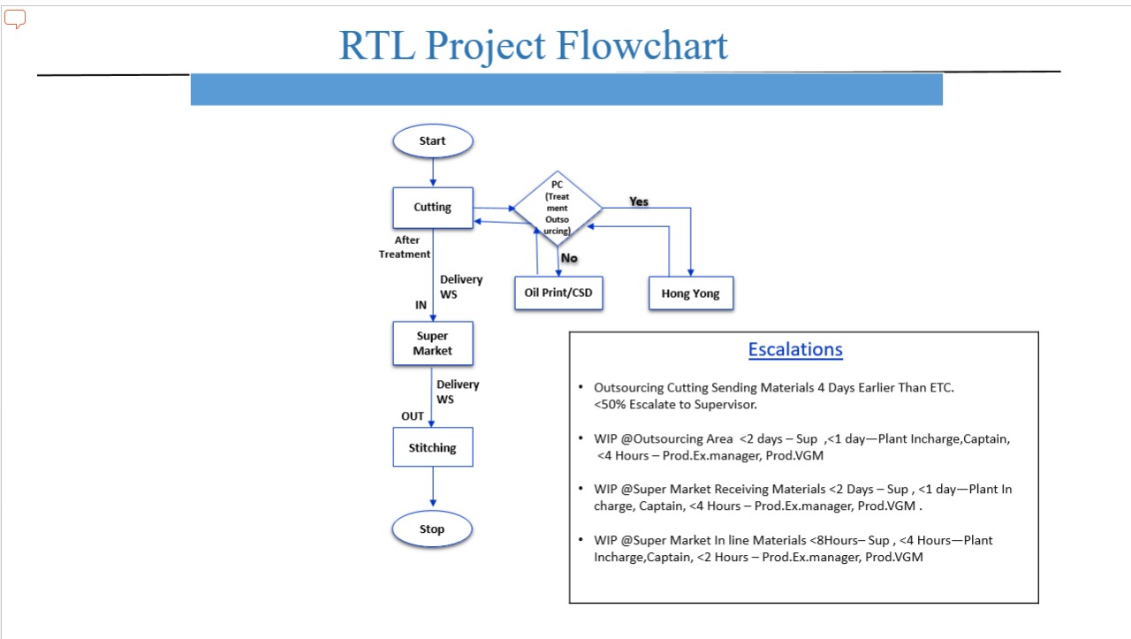
Digitalized
Projects Overall Progress Review

Slide 6
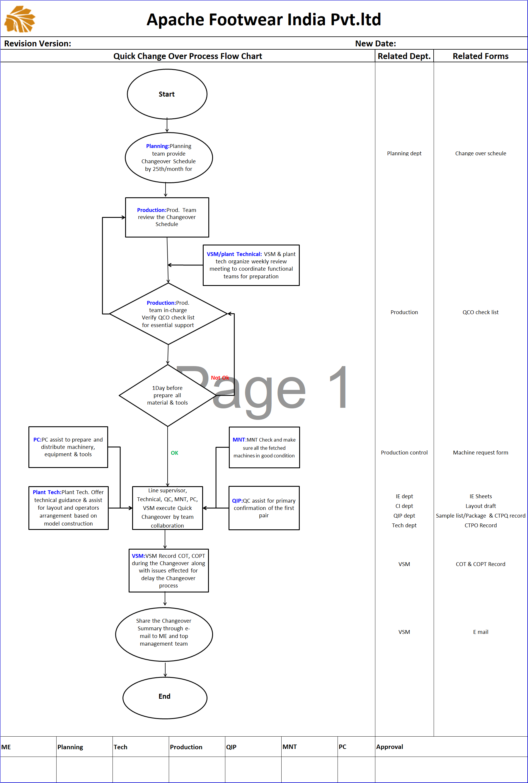
Digitalized
Projects Overall Progress Review
Involved Departments 1.Planning Dept. Planning Team provide Change over Schedule to IE by 20th Of Month 2.Production team PC Team rivew the schedule & Verify QCO check list 3. VSM Will conduct the weekly meeting to coordinate functional teams for preparation change over 4. Production control(PC) PC will distribute Machinery Equipment For Model Change 5.MNT MNT will Maintain all Machinery's in Good Condition 6.Plant Technician Will assist for layout and operator arrangement based on Model change 7.QIP QC assist for Primary confirmation of the first pair 8. VSM VSM record COT,COPT during the Change over
Escalations Once change over schedule is ready QCO system will raise alerts for remind the related Departments . IE, Supervisor Technician, Maintenance/PC, QIP, PC, VSM will get 4days before notification based on department Level wise Once deadline is not meet, will raise warning alerts to related department.

Slide 7
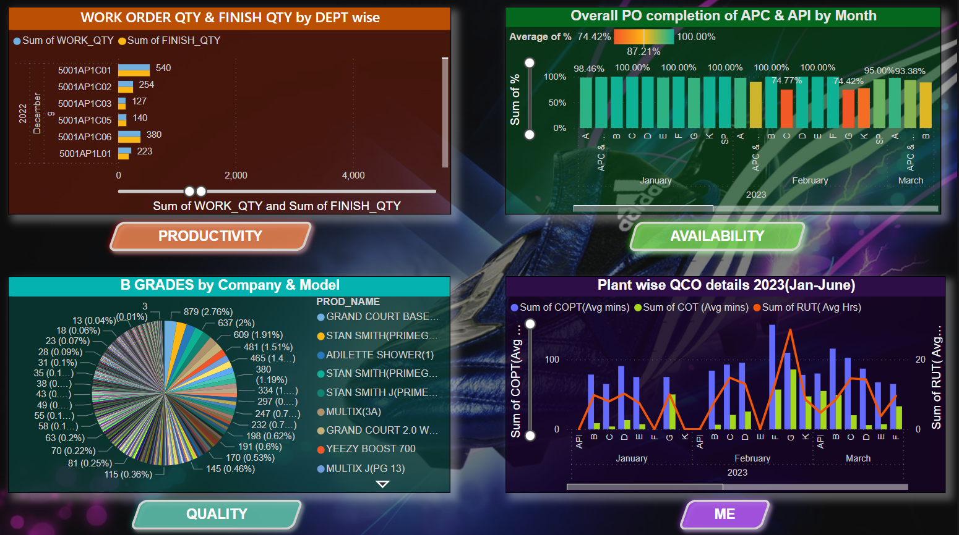
Digitalized
Projects Overall Progress Review
Single Page Data Visualization (BI Report)
(Productivity, Availability, Quality, ME)

Slide 8
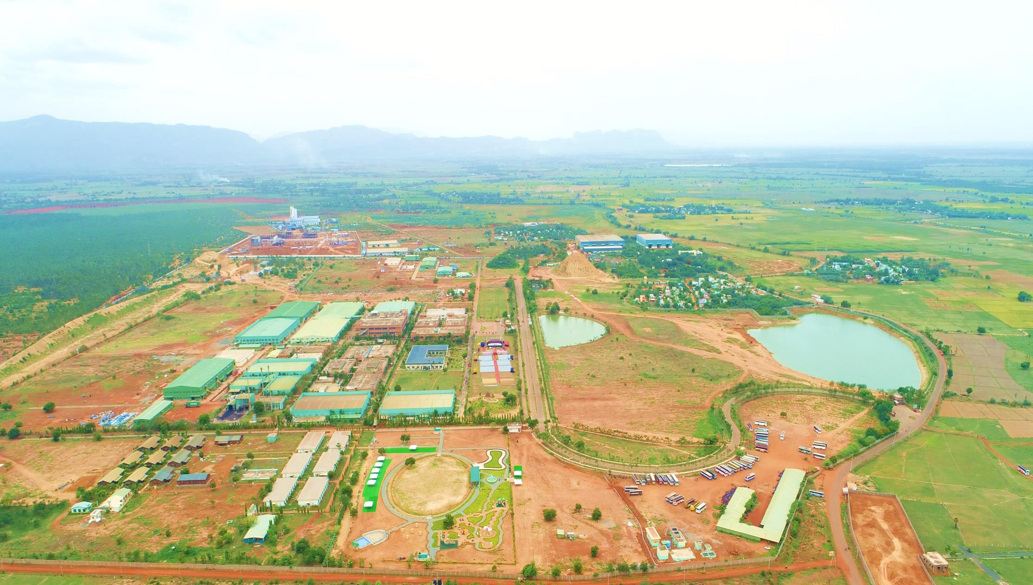



TO BE THE MOST RELIABLE PARTNER

